Slide 1

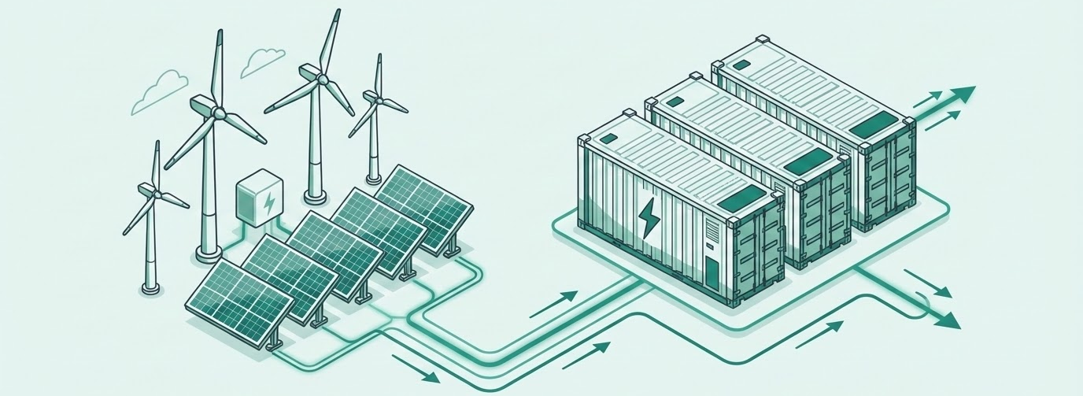
Allotrope DPPA Insights
Samsung SEVT — TTC Duc Hue 2: Vietnam’s First Grid-Connected DPPA
June 2026 — Directional economics (illustrative, not bankable)

Slide 2
Vietnam’s First Grid-Connected DPPA:
Deal at a Glance (live 1 Jun 2026)
Group | Parameter | Value / Basis
Parties | Buyer | Samsung Electronics Vietnam Thai Nguyen (SEVT) — Thai Nguyen, north
 | Generator | TTC Duc Hue 2 solar — Tay Ninh, south (TTC Duc Hue–Long An Power JSC)
Plant | Capacity | 49 MWp DC / 41.4 MWac — ground-mount, no storage
 | Output | ~70 GWh/yr contracted (~19.3% AC capacity factor); ~46,000 t CO₂ avoided/yr
 | Milestones | COD 19 May 2026; DPPA live 1 Jun 2026
Contract | Mechanism | Grid-connected DPPA under Decree 57/2025 (three-contract model)
 | Settlement | Financial contract-for-differences (CfD) vs market reference

Slide 3
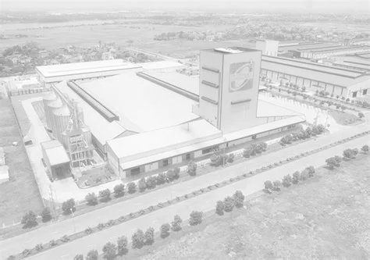
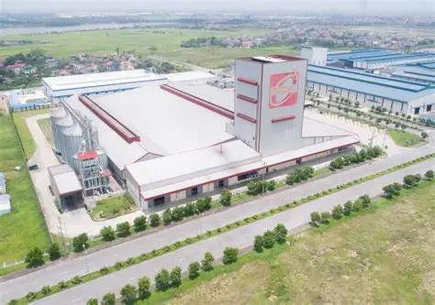
DEAL INFORMATION & STRIKE BASIS
Buyer | Samsung Electronics Vietnam Thai Nguyen (SEVT)
Buyer location | Yen Binh Industrial Park, Thai Nguyen province (north)
Generator | TTC Duc Hue 2 solar farm, Tay Ninh province (south)
Developer | TTC Duc Hue–Long An Power JSC
Capacity | 49 MWp DC / 41.4 MWac, ground-mounted, no storage
Annual volume | ~70 GWh/yr to buyer (~7% of synthetic SEVT load)
Mechanism | Grid-connected DPPA, national grid, Decree 57/2025
Settlement | Financial CfD; generator sells to VWEM spot, settles difference vs SEVT
Strike basis | Anchored to Southern ground-mount ceiling ≈ 1,012 VND/kWh (Decree 57 cap)
Market ref | Proxy CFMP/FMP series (transferred, not site-specific)
Disclosure | Strike, tenor, KPP/grid fee UNDISCLOSED — all numbers DIRECTIONAL
Confidential - For Internal Use by Allotrope & Key Partners - Not Approved for Further Circulation

Slide 4





CONCLUSIONS & RECOMMENDATIONS
Buyer Saves (Directional)
Developer Sub-Economic
Adder Is the Dominant Lever
Regime Stress
Recommendation
At the Southern-ceiling strike (1,012 VND/kWh) the buyer saves ~25.2 B VND/yr (~$0.95M) on the 70 GWh slice: effective 1,552 vs EVN avoided 1,913 VND/kWh. Directional.
PySAM Single Owner NPV runs −$79.7M → −$57.3M across the strike band (IRR null) on a conservative 70 GWh / $750/kW basis. No buyer–developer overlap.
The DPPA grid-service adder (523 VND/kWh, inherited) is the single biggest lever on buyer cost; the buyer flips from saving to a premium near ~0.9× that adder.
Decree 146 two-part tariff trial lifts the buyer’s EVN bill +17.9% (+365 B VND); Decision 14 legacy is -2.1%. A higher bill raises DPPA value unless it double-charges DPPA volume.
Directional position: buyer-favorable, developer sub-economic. Every figure rides on an undisclosed strike and a proxy CFMP series — directional, not bankable.
Confidential - For Internal Use by Allotrope & Key Partners - Not Approved for Further Circulation

Slide 5
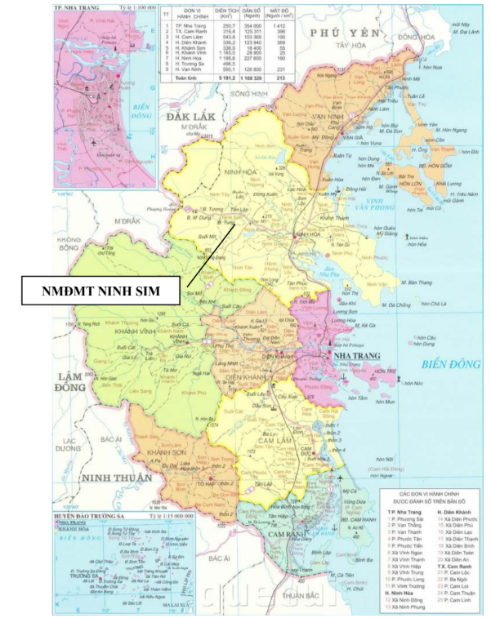
TTC Duc Hue 2:
Plant & Solar Profile (directional)
Plant type | 49 MWp DC / 41.4 MWac ground-mounted solar, no storage
Location | Tay Ninh province, southern Vietnam (high-irradiance)
Annual output | ~70 GWh/yr contracted to SEVT (CfD volume)
Capacity factor | ~19.3% AC; peak ~27.7 MWac (no clipping)
Solar profile | PySAM PVWatts v8 on cached southern Himawari resource, scaled to 70 GWh
CO₂ avoided | ~46,000 tonnes per year

Slide 6
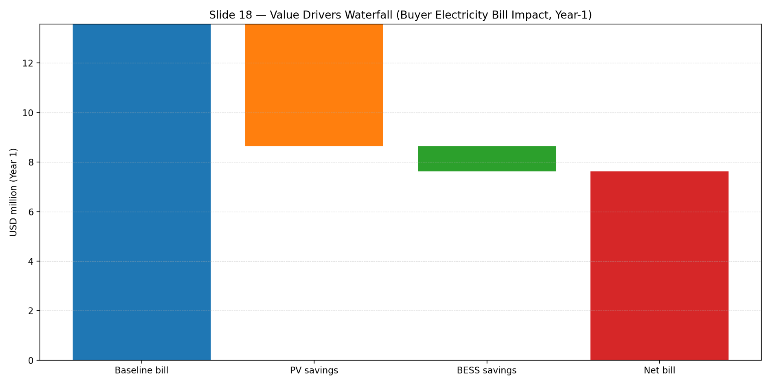
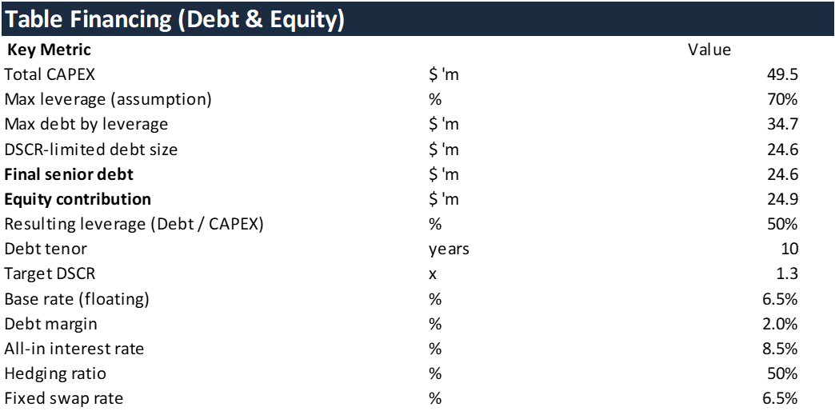
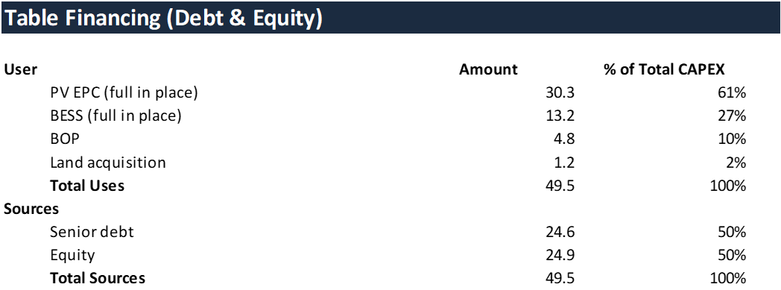
Strike Sweep: Buyer Premium & Developer NPV
Directional: the buyer saves vs EVN below ~1,440 VND/kWh; the developer NPV stays negative across the whole Southern-ceiling → EVN-avoided band (no overlap). Strike basis + proxy CFMP labeled.
Confidential - For Internal Use by Allotrope & Key Partners - Not Approved for Further Circulation

Slide 7

Methodology:
Four-Phase Directional DPPA Screen
We reuse the repo’s tested synthetic/financial DPPA settlement engine (ninhsim Case 2) with the plant pinned to the disclosed 49 MWp / 70 GWh and no storage — a fixed-plant screen, not a re-optimization.
Phase 1 — Case definition: disclosed deal facts, synthetic SEVT load (~1,000 GWh; 70 GWh ≈ 7% RE), strike anchored to the Southern ground-mount ceiling (1,012 VND/kWh).
Phase 2 — Solar + settlement: 49 MWp 8760 via PySAM PVWatts v8 (southern resource, scaled to 70 GWh); hourly CfD settlement and EVN avoided-cost benchmark on the matched slice.
Phase 3 — Strike sweep + developer screen: buyer premium across the strike band and PySAM Single Owner after-tax IRR/NPV at the fixed 49 MWp; plus a DPPA grid-service adder sensitivity.
Phase 4 — Regime stress + decision: GAP-05 toggle (Decision 963 vs Decision 14 vs Decree 146 two-part) and a combined, explicitly caveated recommendation.
Every headline number is flagged DIRECTIONAL with explicit strike + market-reference (proxy CFMP) basis.

Slide 8
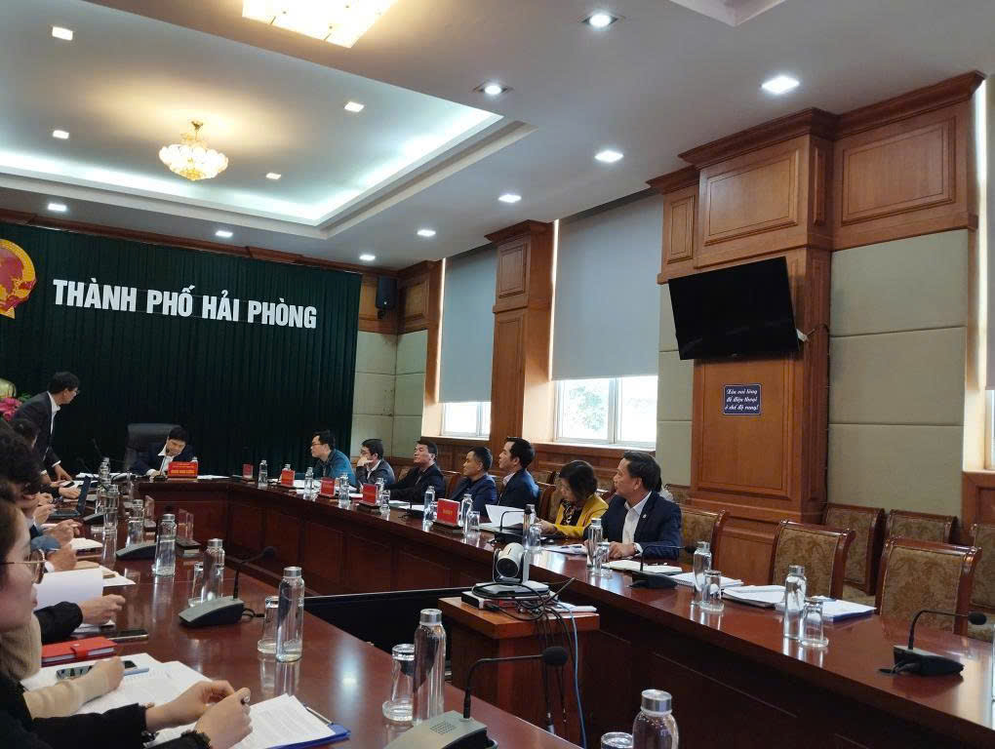
The Dominant Lever:
DPPA Grid-Service Adder Sensitivity
The DPPA grid-service adder — inherited from the Case-2 default at 523.34 VND/kWh — is the single biggest swing factor on the buyer’s effective cost, larger than the strike itself within the regulated band.
Sweeping the adder from 0 to 2×: the buyer’s annual position vs EVN moves from −61.8 B VND (saves) at 0× to +11.4 B VND (premium) at 2×. Break-even is near ~0.9× the inherited adder.
Implication: the adder / KPP grid fee must be deal-calibrated before the sign of the buyer result can be trusted. Directional only.

Slide 9
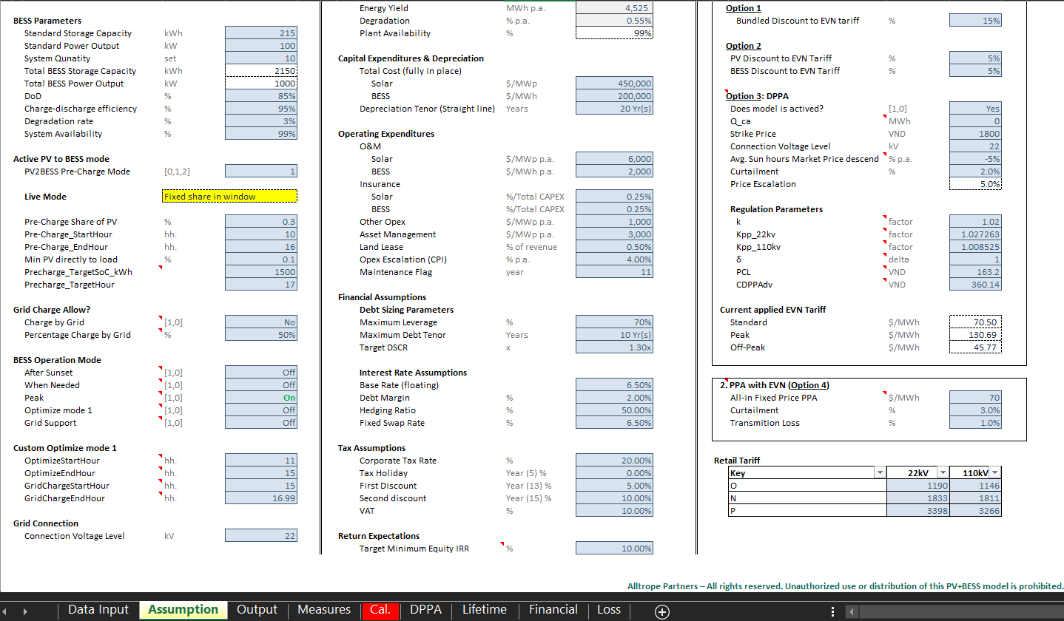
Regime Stress:
Buyer EVN Bill Across Tariff Regimes
The buyer’s EVN bill is the DPPA’s outside option: a higher bill raises the avoided-cost value of the contract. We stress the synthetic SEVT load across three regimes via the GAP-05 toggle.
Decision 963/2026 (current): baseline. Decision 14/2025 legacy: -2.1%. Decree 146/2025 two-part trial: +17.9% (+365 B VND) from the capacity charge.
Caveat:
the Decree 146 two-part trial is a paper trial, not yet on actual bills, and it risks double-charging capacity on the DPPA volume — which would erode the buyer savings shown elsewhere in this deck. Directional.

Slide 10
Context:
Decree 57/2025 & the Vietnam DPPA Market
Decree 57/2025 grid-connected DPPA — a three-contract model:
1) Forward CfD between generator and buyer; 2) generator sells physical output to the VWEM spot market; 3) buyer continues to buy from EVN and settles the difference. The two sites are ~1,500 km apart (buyer north, plant south), the definitional signature of a financial (not private-wire) DPPA.
Forward price is left to bilateral negotiation but capped at the RE-type ceiling generation tariff — Southern ground-mount, no storage ≈ 1,012 VND/kWh — which anchors our strike floor.
Buyer avoided cost: EVN production tariff (base 2,204 VND/kWh × ~0.85 standard-hour multiplier ≈ 1,873–1,913 VND/kWh), since solar delivers in standard TOU hours under Decision 963.
Forward risk: the Decree 146 two-part (capacity + energy) tariff trial can double-charge capacity on DPPA volume and erode buyer savings — the key regime to watch.
Notes:
Email background:
“Her initial feedback on our proposal is to shift the focus away from technology and specific companies.”
“Instead, she would like to see more emphasis on overall market and policy advancement, integrated through the outputs of the pilots and case studies rather than as a separate point.”

Slide 11
Risks & Open Questions:
What Makes These Numbers Directional
Why directional, not bankable:
Strike price is undisclosed — anchored to the Southern ceiling (1,012 VND/kWh) and swept to EVN avoided cost (~1,873). The buyer result’s sign depends on where the real strike sits.
Market reference (CfD leg) uses a proxy CFMP/FMP series transferred from another site, not a Duc Hue 2 series.
The DPPA grid-service adder / KPP grid fee is inherited from Case 2 (523 VND/kWh) and is the dominant lever — it must be deal-calibrated.
Solar 8760 is from a representative southern resource scaled to 70 GWh, not a site-specific Tay Ninh dataset; developer NPV uses conservative $750/kW capex on the contracted 70 GWh (excludes merchant tail).
Recommended position (directional):
Buyer-favorable, developer sub-economic on the contracted slice — no buyer–developer overlap under conservative assumptions. To move toward bankable: source the actual strike & tenor, a Duc Hue 2 FMP/CFMP series, the negotiated KPP/grid fee, and SEVT’s real 8760 load and connection voltage.
Notes:
Details on March 13th submission window?
When do we need to share a draft for Yen’s feedback prior to that?

Slide 12


Allotrope — DPPA Insights
Sources: pv-magazine, TheInvestor.vn, VnEconomy, Reccessary;
Norton Rose Fulbright & A&O Shearman (Decree 57); EVN/MOIT solar ceilings.
All deal economics DIRECTIONAL: undisclosed strike + proxy CFMP basis.

